Slide 1
TA如何協助學習成效確保(AoL)
AACSB 工商系代表
王勝本老師
Notes:
[相片是2009年12月院長、文老師、景宜去Gonzaga Univ.商談交換學生時，在Spokane的飯店的照片]

Slide 2
AoL是什麼?
Assurance of Learning
學習成效確保
必須提供證據，支持學生畢業時有獲得院系所規劃的能力
必須要能夠【Close the Loop】
  執行AoL的結果有具體例子回饋到改進整體課程規劃上，且呈現出效果
AACSB 來實地訪評/認證時，成敗的關鍵

Slide 3
系所學程區分說明
BS
  工商系大學部、醫管系大學部、資管系大學部
MS
  工商系碩士班、醫管系碩士班、資管系碩士班
MBA
  商管專業學院碩士學位學程
EMBA
  商管專業學院碩士在職專班
PHD
  管理研究所博士班

Slide 4
目前版本的學習目標

Slide 5
BS-醫管(I)
1. Understanding of Health Care Management.
  1-1. Our students will understand the core foundations of management.
  1-2. Our students will understand the determinants of health.
  1-3. Our students will understand the socio-economic aspects of health services organization and delivery.
  1-4. Our students will demonstrate an understanding of basic management theories.
2. Relating the knowledge of healthcare management to practice.
  2-1. Our students will acquire basic skills in management functions, including financial, human resources, operations, information systems, and marketing management.
  2-2. Our students will demonstrate an understanding of managerial knowledge and skills.
  2-3. Our students will demonstrate an understanding of the structure and function in health-related organizations.

Slide 6
BS-醫管(II)
3. Problem-solving skills.
  3-1. Our students will be able to describe the systematic approach to problem-solving.
  3-2. Our students will be able to systematically identify a problem and find a feasible solution by leveraging proper management skills.
4. Communication skills .
  4-1. Our students will be able to deliver a quality presentation.
  4-2. Our students will be able to use interpersonal communication skills effectively.
  4-3. Our students will be able to produce quality documents.
5. Understanding of ethics and responsibility .
  5-1. Our students will be able to understand ethics issues.
  5-2. Our students will exhibit understanding of the professional code of conduct in their discipline.

Slide 7
BS-工商(I)
1. Understanding of the knowledge in industrial and business management.
  1-1. Our students will understand the core foundations of management.
  1-2. Our students will acquire the function knowledge in human resources.
  1-3. Our students will acquire the function knowledge in finance.
  1-4. Our students will acquire the function knowledge in marketing.
  1-5. Our students will acquire the function knowledge in operations.
2. Relating the knowledge of industrial and business management to practice.
  2-1. Our students will possess analytical skills for management functions.
  2-2. Our students will demonstrate an understanding of managerial skills, including leadership and team process.

Slide 8
BS-工商(II)
3. Problem-solving skills.
3-1. Our students will be able to describe the systematic approach problem-solving.
3-2. Our students will be able to systematically identify a business problem and develop a feasible solution.
4. Communication skills.
  4-1. Our students will be able to deliver a quality presentation.
  4-2. Our students will be able to use interpersonal communication skills effectively.
5. Understanding of ethics and responsibility .
  5-1. Our students will be able to understand ethics issues.
  5-2. Our students will exhibit understanding of the professional code of conduct in their discipline.

Slide 9
BS-資管(I)
1. Understanding of Information Management (IM).
  1-1. Students will understand the core foundations of management.
  1-2. Students will exhibit understanding of management knowledge in business functions.
  1-3. Students will acquire some understanding of foundations and practices of information management.
2. Understanding of Information Technology (IT) and its applications.
  2-1. Students will have programming capability.
  2-2. Students will acquire some understanding of information technology foundations.
  2-3. Students will acquire some understanding of information technology applications.

Slide 10
BS-資管(II)
3. Problem-solving skills.
  3-1. Students will be able to describe a systematic approach of problem-solving.
  3-2. Students will be able to identify problems within a given context and provide feasible solutions.
4. Communication skills.
  4-1. Students will be able to deliver a quality presentation.
  4-2. Students will be able to use interpersonal communication skills effectively.
  4-3. Students will be able to produce professional documents.
5. Understanding of ethics and responsibility.
  5-1. Students will be able to understand ethical issues.
  5-2. Students will exhibit understanding of the professional code of conduct in their discipline.

Slide 11
MS-醫管
​1. ​Understanding of Health Care Management..
  1-1. Our students will be able to measure population health and determinants.
  1-2. Our students will learn about health policy formulation and conduct policy evaluation.
  1-3. Our students will understand healthcare management theories.​
2. Understanding of Health Care Management and its applications.
  2-1. Our students will be equipped with analytical & decision making skills in healthcare.
  2-2. Our students will have writing, verbal, and interpersonal communication skills in healthcare management.​
3.​ Problem-solving skills.
  3-1. Our students will be able to identify problems.
  3-2. Our students will be able to generate alternatives.
  3-3. Our students will be able to develop a solution.​
4. Familiar with current practices/ business conducts in international contexts.
  4-1. Our students will be able to describe differences in current business practices between different environment (e.g. cultural, legal or social) .
  4-2. Our students will be able to apply international practices to domestic setting.

Slide 12
MS-工商(I)
1. Understanding of Industrial and Business Management and its applications.
  1-1. Our students will understand key subjects in Logistics/ Operations.
  1-2. Our students will understand key subjects in Finance.
  1-3. Our students will understand key subjects in Business Analytics. .
2. Problem-solving skills.
  2-1. Our students will understand research methods.
  2-2. Our students will develop a satisfactory solution.
3. Communication skills.
  3-1. Our students will be able to deliver a quality presentation.
  3-2. Our students will be able to use interpersonal communication skills effectively.
4. Understanding of ethics and responsibility.
  4-1. Our students will understand ethics issues.
  4-2. Our students will exhibit understanding of the professional code of conduct in their discipline.

Slide 13
MS-資管(I)
1. Understanding of Information Technology (IT) and its applications.
  1-1. Students will grasp the knowledge of information technology.
  1-2. Students will demonstrate an understanding of information technology applications.
2. Understanding of Information Management (IM).
  2-1. Students will demonstrate an understanding of management theories.
  2-2. Students will demonstrate an understanding of current global practices in relation to information management.
3. Problem-solving skills.
  3-1. Students will be able to grasp the essence of a problem and related methods.
  3-2. Students will be able to develop solutions.

Slide 14
MS-資管(II)
4. Communication skills.
  4-1. Students will demonstrate the capability of delivering effective oral presentations.
  4-2. Students will demonstrate the capability of generating professional documents.
5. Understanding of ethics and responsibility.
  5-1. Students will be able to understand and handle ethical issues.
  5-2. Students will exhibit understanding of the professional code of conduct in their discipline.

Slide 15
MBA
1. Applying theories into practices.
  1-1. Our students will be able to identify appropriate theories and associated boundary conditions.
  1-2. Our students will be able to devise action plans.
2. Problem-solving skills.
  2-1. Our students will be able to identify business problems.
  2-2. Our students will be able to develop alternatives from strategic perspectives.
  2-3. Our students will be able to assess alternatives and make the decision.
3. Conducting business skills in international contexts.
  3-1. Our students will be able to describe differences in current business practices between different environment (e.g. cultural, legal or social).
  3-2. Our students will be able to adapt international practices into domestic setting.
  3-3. Our students will be able to demonstrate English proficiency.
4. Understanding of ethics and responsibility.
  4-1. Our students will exhibit understanding of the professional code of conduct in their discipline.
  4-2. Our students will identify an ethical dilemma and propose a resolution.

Slide 16
EMBA
1. Applying theories into practices.
  1-1. Our students will be able to identify appropriate theories and associated boundary conditions.
  1-2. Our students will be able to devise action plans.
2. Problem-solving skills.
  2-1. Our students will be able to identify business problems.
  2-2. Our students will be able to develop alternatives from strategic perspectives.
  2-3. Our students will be able to assess alternatives and make the decision.
3. Conducting business skills in international contexts..
  3-1. Our students will be able to describe differences in current business practices between different environment (e.g. cultural, legal or social).
  3-2. Our students will be able to adapt international practices into domestic setting.
4. Understanding of ethics and responsibility.
  4-1. Our students will exhibit understanding of the professional code of conduct in their discipline.
  4-2. Our students will identify an ethical dilemma and propose a resolution.
5. Leading organizations or teams for continuous improvement.
  5-1. Our students will be able to inspire and influence others.
  5-2. Our students will be able to coordinate efforts of team members.

Slide 17
PHD
1. Understanding of advanced management-related knowledge.
  1-1. Our students will exhibit understanding of management-related theories.
  1-2. Our students will be able to integrate management-related theories.
2. Understanding of research methodology.
  2-1. Our students will master one of either quantitative or qualitative research methods.
  2-2. Our students will be able to justify their choice of research methods for a research project.
3. Able to complete a dissertation that makes original intellectual contributions.
  3-1. Our students will be able to understand professional ethics.
  3-2Our students will exhibit understanding of knowledge in their chosen fields..
  3-3. Our students will be able to defend the originality of the intellectual contributions of their dissertation.

Slide 18
PHD
4. Our students will be capable of publishing their research work.
  4-1. Our students will be able to present papers at international conferences.
  4-2. Our students will be able to publish peer-reviewed journal papers.
5. Our students will exhibit understanding of research pertaining to healthcare-related fields.
  5-1. Our students will exhibit understanding of theories applicable to healthcare-related fields.
  5-2. Our students will exhibit understanding of recent research advancements pertaining to healthcare-related fields.

Slide 19
各教師執行AoL之時程表
第1-3週
1.審閱與修正評分表
執行AoL教師
第3週
2.收發與解釋評分表
執行AoL教師
第4-18週
3.評估學生學習成效
執行AoL教師
第16-18週
4.繳交評分與佐證資料
提出成果報告
執行AoL教師
改善整體課程規劃
院課委會

Slide 20
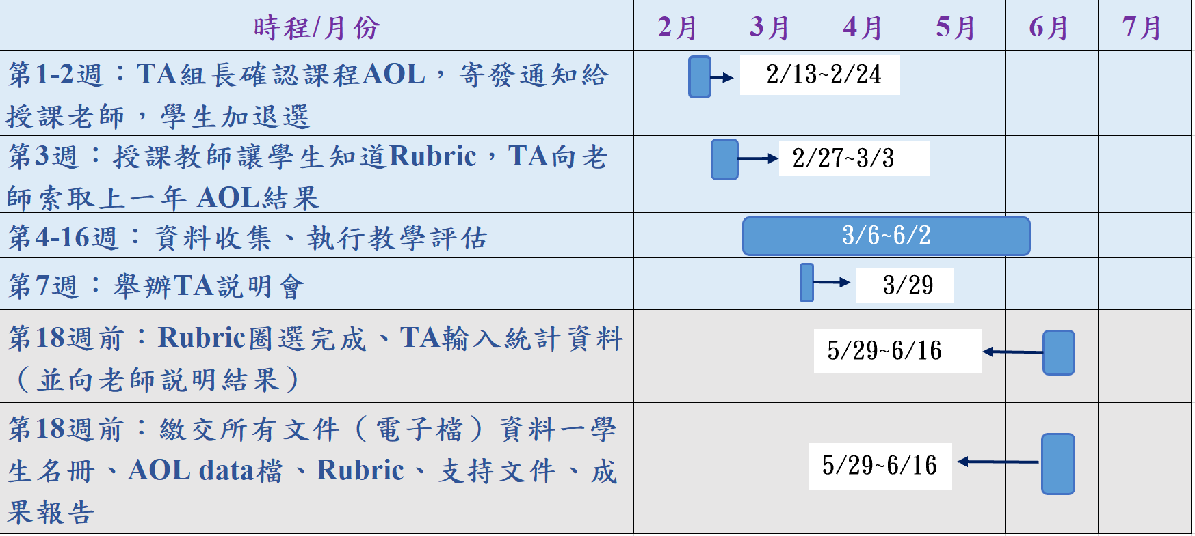
111（2）學期
AoL 工作時程表

Slide 21
執行AoL教師期末需繳交
重要
1. 已評分之評分表(scored rubrics)
  一位同學一個學習目標
  其上有該生姓名、學號、於各評分項目的圈選
2. 支持評分的文件(supporting documents)
  報告、作業、或考試(試卷及答案卷)的影本
3. 學生名冊電子檔
  由校務資訊系統下載
4. AoL數據檔
5. 成果報告
均需TA協助彙整

Slide 22
BS-LG3-LO1: Systematically Solving Problem
Assessed Student Body: All students in the class were assessed.
Department of Health Care Management, College of Management, Chang Gung University
Program Learning Goal: Our students will be able to solve problems.
Program Learning Objective: Our students will be able to describe the systematic approach to problem-solving.
Assessment Year and Semester:
Course: | Student Name and Number:
Course Instructor: | Rubric Score:
Assessment Item and Explanation: Each student was asked to read and analyze a case or a problem.
Criteria Standards | Not Yet Competent (1) | Competent (2) | Exemplary (3)
Steps for solving a problem | Steps were not listed for solving a problem. | Steps were listed for solving a problem. | Steps were listed and justified for solving a problem.
Criteria for solving a problem | Criteria were not listed for solving a problem. | Criteria were listed for solving a problem. | Criteria were listed and justified for solving a problem.
Logics connecting steps and criteria | Steps and criteria were neither logically connected nor connected with major flaws. | Steps and criteria were logically connected with minor flaws. | Steps and criteria were logically connected without flaws.

Slide 23
1. 已評分之評分表彙整(I)
確認張數
  學生人數 x 該課程所對應的學習目標數
  例如：50位學生 x 2個學習目標 = 100張
確認每人張數
  每位同學每個學習目標恰好有一張
確認有評分
  每張評分表上的每一行，恰有一個圈選
整理排列順序
  排列順序需與學生名冊電子檔一致

Slide 24
1. 已評分之評分表彙整(II)
其電子檔文件需繳交予各系所(匯整AOL）的TA小組長(無需繳交紙本)
必須繳交所有有受評量的學生的資料

Slide 25
2. 支持評分的文件彙整(I)
確認份數
  應恰好為學生人數 x 該課程的學習目標數
確認每人份數
  每位同學每個學習目標恰好有一份
確認有批改
  確認每份文件上，均有教師批改的記錄
整理排列順序
  排列順序需與學生名冊電子檔一致

Slide 26
2. 支持評分的文件彙整(II)
其電子檔文件需繳交予各系所(匯整AOL）的TA小組長
必須繳交所有有受評量的學生的資料

Slide 27
3.學生名冊電子檔(I)
確認電子檔格式與可開啟
  確認電子檔為 excel 格式
  確認電子檔可以開啟
確認電子檔內容
  確認電子檔內前三個欄位為【系所名稱】、【學號】、(學生的)【姓名】
  前三個欄位資訊完整
  若有第四與第五個欄位，則應該是【排除】、【原因】

Slide 28
3.學生名冊電子檔(II)
檔名必須為[program]-[教師姓名]-[課名]-學生名冊
  例如：BS-鄧景宜-行銷管理-學生名冊
  Program請由BS/MS/MBA/EMBA/PHD擇一
  可排除特定學生，請於【排除】欄位標示 x (小寫的英文字母)，並於【原因】欄位填寫原因(可包括：休學、停修)

Slide 29
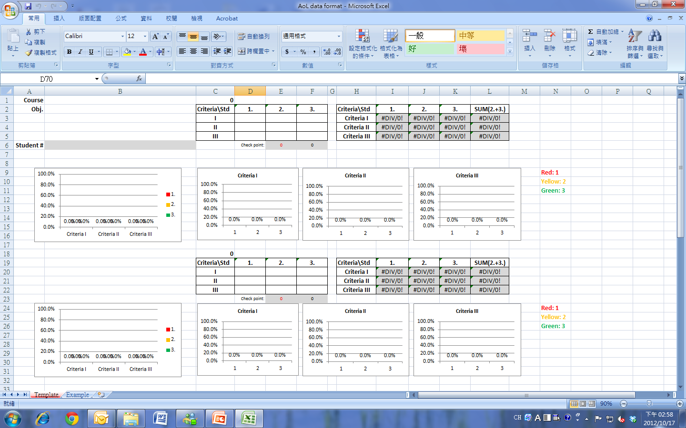
4.AoL數據整理
請參考【AoL Data Format.xls】 第一個活頁
需填入拿到該分數之「學生人數」
需填入對應之學習目標與學生人數
檢核: 是否有漏/重複Keyin

Slide 30
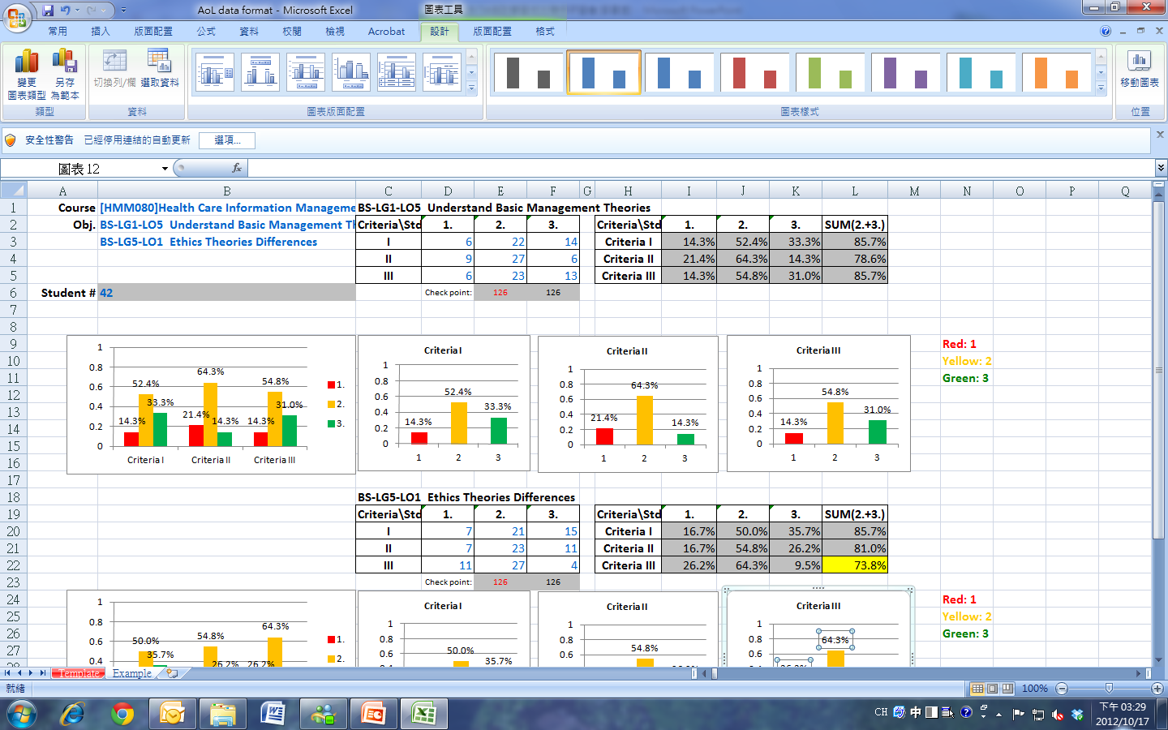
4.AoL數據整理
請參考【AoL Data Format.xls】第二個活頁
需填入對應之學習目標與學生人數
需填入拿到該分數之「學生人數」
檢核: 是否有漏/重複Keyin
低於75%者以黃色標記

Slide 31
4.AoL數據整理
  如何填入「拿到該分數之學生人數」
  例如：42名學生中，在Criterion I 拿1分的有6名，拿2分的有22名，拿3分的有14名…以此類推，分別填入九宮格中。(也有可能是6宮格或更多)
Criteria\Std | 1. | 2. | 3.
I | 6 | 22 | 14
II | 9 | 27 | 6
III | 6 | 23 | 13
單行加總=學生總人數
行列加總= 學生人數*3(視criteria多寡而定)
檔名[program]-[教師姓名]-[課名]-AoL結果
  例如：BS-鄧景宜-行銷管理-AoL結果.xls

Slide 32
4.AoL數據整理
  如何向授課教師解釋數據意義?
  例如：Criterion III拿到2分或3分之學生人數低於75%，應針對Criterion III進行檢討
  可針對Criterion III 之個別分數分佈進行探討原因。
  將彩色長條圖或表格貼入成果報告中，便於對照說明。
  ※ 若有問題可請教該課程對應之系所 AoL Coordinator
Criteria\Std | 1. | 2. | 3. | SUM(2.+3.)
Criterion I | 16.7% | 50.0% | 35.7% | 85.7%
Criterion II | 16.7% | 54.8% | 26.2% | 81.0%
Criterion III | 26.2% | 64.3% | 9.5% | 73.8%

Slide 33
5.AoL成果報告(I)
先持該門課程【AoL結果.xls】向教師說明
請參考【成果報告範例.doc】提供報告
必須與該範例格式接近
各資訊欄位可增加，但不可減少
若教師所繳交的成果報告格式不正確
  請代為修正/剪貼至範例檔案中
  若有遺漏資訊，也再向教師請教/索取

Slide 34
5.AoL成果報告(II)
檔案中所有資訊都必須是正確且最新的
要繳交電子檔

Slide 35
彙整文件繳交(I)
應於18週前繳交，直到簽收完成為止
其電子檔文件需繳交予各系所(匯整AOL）的TA小組長
必須現場簽收
  繳交教師所提供的電子檔

Slide 36
一般性原則(I)
與教師互動
  能協助教師之處，請主動協助，應盡力完成
  要注意保持與師長的應對禮儀
  拜訪教師前，最好先預約
找授課教師的時間
  下週即應向授課教師報到，提供TA的通訊資料
  第14週應再提醒授課教師一次
  第14週起，在完成前，原則上每周要拜訪授課教師兩次，請教TA可協助AoL之處

Slide 37
一般性原則(II)
須符合各項標準
  若有未達到以上標準者，請TA洽授課教師：TA如何能夠協助其達到以上標準
以電子檔為主
各份文件自成一疊
  例如：1.已評分的評分表自成一疊、2.支持評分的文件自成一疊

Slide 38
特別注意事項
重要
保密原則
  未經院長核可，不得將管院AACSB (含AoL)相關文件、電子檔以任何形式公開或流傳
期限(第18週結束)後仍未完成的TA的姓名，將每周持續呈報給院系所主管
  直到完成為止
  可能會對TA有什麼影響？

Slide 39
例外情況處理
若教師一個學習目標衡量多次(例如：3次)
  則已評分的評分表、支持評分的文件都必須恰好是該倍數(例如：3倍)的數量
若教師對執行的程序/方式有疑慮
  可請教該課程對應之系所 AoL Coordinator
  工商：王勝本老師
  醫管：文羽苹老師
  資管：陳昱仁老師
  管研：鄧景宜老師
  商管：張恆瑜老師

Slide 40
參與的學生人數？
一門課受評學生若為20人或以下
  原則上該門課的學生均(100%)須參與
一門課受評學生若超過20人且執行有困難
  則可隨機挑選20人(含)且全班人數20%以上
  但須說明【隨機化程序】
  且須說明【執行困難的原因】

Slide 41


